Slide 1
Basic Motivation Concepts
6–<number>

Slide 2
After studying this chapter, you should be able to:
Outline the motivation process.
Describe Maslow’s need hierarchy.
Contrast Theory X and Theory Y.
Differentiate motivators from hygiene factors.
Explain the job characteristics model.
State the impact of under rewarding employees.
Clarify key relationships in expectancy theory.
L E A R N I N G O B J E C T I V E S
6–<number>

Slide 3
Defining Motivation
Motivation
The processes that account for an individual’s intensity, direction, and persistence of effort toward attaining a goal.
Key Elements
Intensity: how hard a person tries
Direction: toward beneficial goal
Persistence: how long a person tries
6–<number>

Slide 4
According to Hellman and Horn stein
"Motivation is the individuals desire to work”
Motivation means an individuals needs, desires and concepts that cause him or her to act in a particular manner
6–<number>

Slide 5

Hierarchy of Needs Theory (Maslow)
Hierarchy of Needs Theory
There is a hierarchy of five needs—physiological, safety, social, esteem, and self-actualization; as each need is substantially satisfied, the next need becomes dominant.
6–<number>

Slide 6
Physiological
Includes hunger, thirst, shelter, and other bodily needs.
Safety
Includes security and protection from physical and emotional harm.
Social
Includes affection, belongingness, acceptance, and friendship
6–<number>

Slide 7
Esteem
Internal esteem factors: self-respect, autonomy, and achievement;
External esteem factors: status, recognition, and attention.
Self-actualization
The drive to become what one is capable of becoming; includes growth, achieving one’s potential, and self-fulfillment
6–<number>

Slide 8
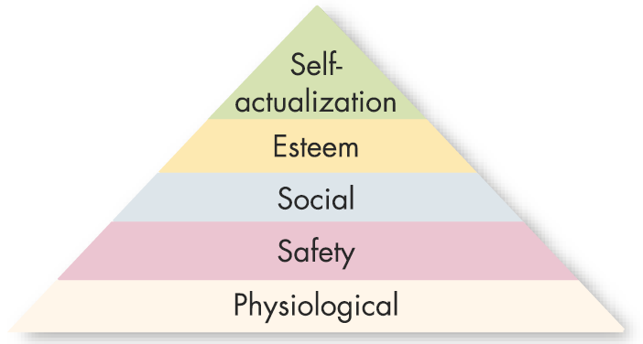
Maslow’s Hierarchy of Needs
Lower-Order Needs
Needs that are satisfied externally; physiological
and safety needs.
Higher-Order Needs
Needs that are satisfied
internally; social, esteem,
and self-actualization
needs.
6–<number>

Slide 9
How to Apply?
If you want to motivate some one, according to Maslow, you need to understand what level of the hierarchy that person is currently on and focus on satisfying the needs or above that level.
6–<number>

Slide 10


Theory X and Theory Y (Douglas McGregor)
Theory X
Assumes that employees dislike work, lack ambition, avoid responsibility, and must be directed and coerced to perform.
Theory Y
Assumes that employees like work, seek responsibility, are capable of making decisions, and exercise self-direction and self-control when committed to a goal.
6–<number>

Slide 11

Two-Factor Theory (Frederick Herzberg)
Two-Factor (Motivation-Hygiene) Theory
Intrinsic factors are related to job satisfaction, while extrinsic factors are associated with dissatisfaction.
Hygiene Factors
Factors—such as company policy and administration, supervision, and salary—that, when adequate in a job, placate workers. When factors are adequate, people will not be dissatisfied.
6–<number>

Slide 12
Two-Factor Theory (Frederick Herzberg)
Motivational Factors
advancement, recognition, responsibility, and achievement
6–<number>

Slide 13
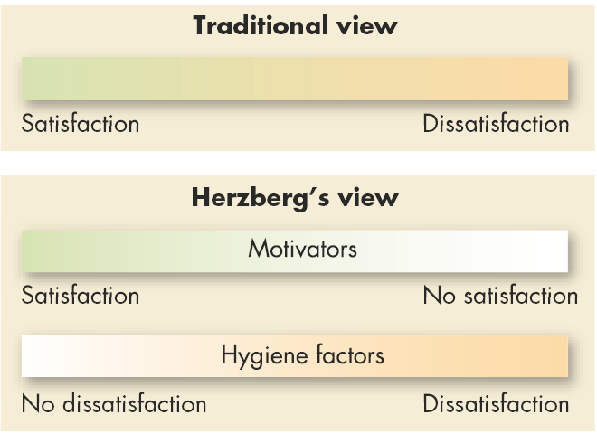
Contrasting Views of Satisfaction and Dissatisfaction
6–<number>

Slide 14
Job Design Theory
Job Characteristics Model
Identifies five job characteristics and their relationship to personal and work outcomes.
Characteristics:
Skill variety
Task identity
Task significance
Autonomy
Feedback
6–<number>

Slide 15
Job Characteristics Model
Skill variety
  Extent to which work allows employee to use variety of skills
Task identity
  Extent to which work allows employee to complete whole or identifiable piece of work
Task significance
  Extent to which employee perceives that work is important and meaningful to those inside or outside organization
Autonomy
  Extent to which employee is able to work and determine work procedure at own discretion
Feedback
  Extent to which work allows employee to gain sense of how well job responsibilities are met
6–<number>

Slide 16
Job Design Theory (cont’d)
Job Characteristics Model
  Jobs with skill variety, task identity, task significance, autonomy, and for which feedback of results is given, directly affect three psychological states of employees:
    Knowledge of results
    Meaningfulness of work
    Personal feelings of responsibility for results
  Increases in these psychological states result in increased motivation, performance, and job satisfaction.
6–<number>

Slide 17
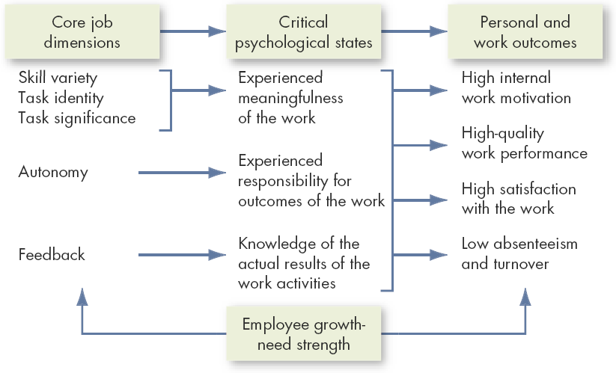
The Job Characteristics Model
6–<number>

Slide 18
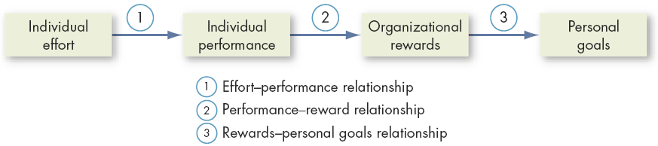
Expectancy Theory
Expectancy Theory (Victor Vroom)
The strength of a tendency to act in a certain way depends on the strength of an expectation that the act will be followed by a given outcome and on the attractiveness of that outcome to the individual.
6–<number>

Slide 19
Expectancy Theory Relationships
Effort–Performance Relationship
  The probability that exerting a given amount of effort will lead to performance.
Performance–Reward Relationship
  The belief that performing at a particular level will lead to the attainment of a desired outcome.
Rewards–Personal Goals Relationship
  The degree to which organizational rewards satisfy an individual’s goals or needs and the attractiveness of potential rewards for the individual.
6–<number>

Slide 20
Importance of motivation
Obtaining job satisfaction
Increase productivity
Favorable group behavior
Increase sales and profit
Change becomes possible
Maximum efficiency and success are attained.
It increase team spirit
Reduce strike, boycott, go slow, lockout
Reduce labor turnover and absenteeism
Clarance Francis said, " You can buy a man's time, you can buy a man's physical presence at a given place, but you cannot his initiate, loyalty and enthusiasm”
6–<number>

Slide 21
Sources of motivation
Financial Sources
Fair wage
Bonus
Promotion
Accommodation facilities
Transportation facilities
Medical facilities
Education facilities
Insurance facilities
Participation in profit
6–<number>

Slide 22
Non Financial Sources
Job security
Praise, recognition and reward
Feed back
Participation in management
Opportunity for promotion
Goodwill
Training facilities
Comfortable and attractive working conditions
Co-worker with same mind and sense
Good supervision
Good relationship among workers
Sound management
Treating personnel problems with sympathy
6–<number>

